Slide 1

SEMINAR TOPIC :-
BUSINESS INTeLLIGENCE..
DEPARTMENT :- INFORMATION TECHNOLOGY
GUIDE BY :-
DISHA PATEL(MADAM).

Slide 2
INFORMATION TECHNOLOGY
I.T. :- 1
BATCH :- B
PREPARED BY:-
NAME ENROLL NO.:-
GANDHI KARAN B. 160410116034

Slide 3
Introduction
What is Business Intelligence (BI)? This is the main question that comes to mind when discussing this complex subject. According to Hannula et al, it is the Systematic business information acquisition and analysis. In addition, it is also called Competitive Intelligence, Corporate Intelligence, Market Intelligence, Market Research, Data Warehousing, and Knowledge Management. As you can tell it is a very broad subject with many definitions.
BI has been around for a long time. As illustrated in the class presentation, BI is nothing more than the gathering of information to give your business an advantage over your competitors, whether it concerns rugs and carpets or the building of combat aircraft.
The purpose of this paper is to explore every facet of Business Intelligence, including internal and external BI and the tangible/intangible aspects leading to a competitive advantage. Internal BI refers to the protection and utilization of internal data and external BI refers to the gathering of data and information about the competition.

Slide 4
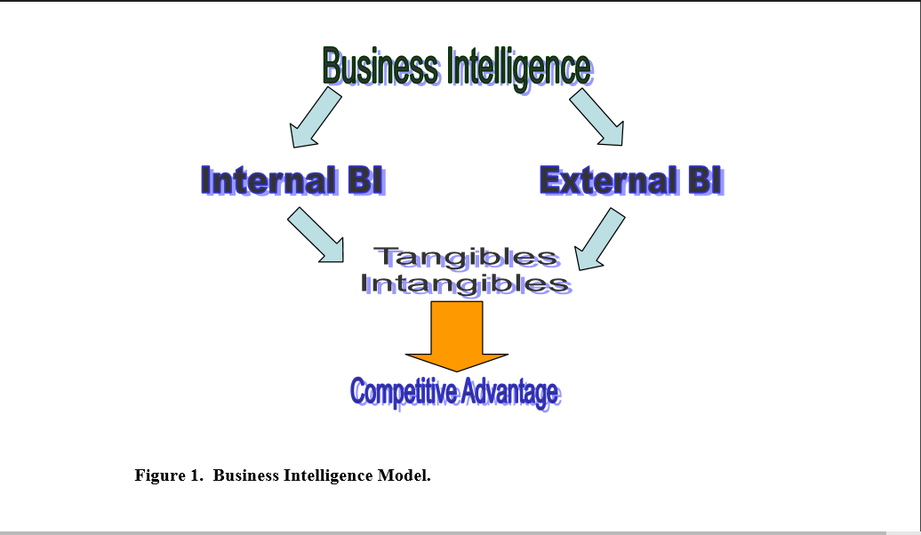

Slide 5
Internal Business Intelligence and Espionage
To paraphrase an interpretation of Sun Tzu’s “The Art of War”; it will not do for a corporation to act without knowing the competition’s strategy, and to know the competition’s strategy is impossible without espionage.
Sun Tzu created his strategy and philosophy over 2000 years ago and the Japanese still apply it today for business and politics.
It is very important to understand the classifications of espionage and how a business can protect its physical and intellectual assets from competitors.

Slide 6
According to CIA there are three types of Espionage when dealing with trade secrets, businesses intelligence and competitive advantage:
• Industrial Espionage –
Foreign government vs. Domestic Business.
• Business Espionage –
Foreign or Domestic Business vs. Domestic Business.
• Corporate Espionage –
Legal and ethical intelligence gathering by Domestic Businesses, for a competitive advantage.

Slide 7
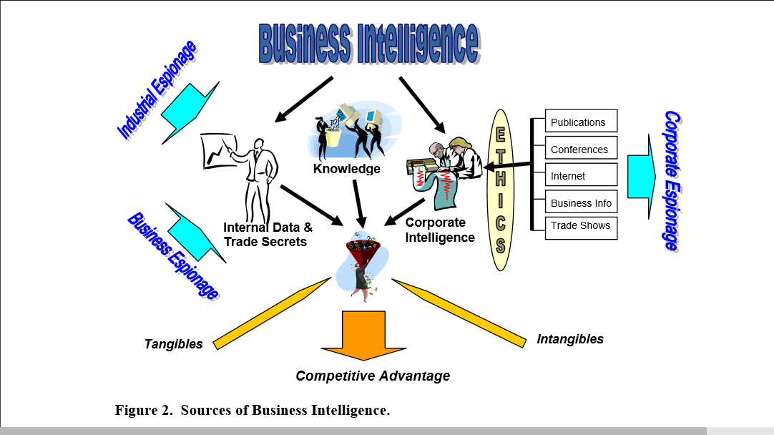

Slide 8
External Business Intelligence
External BI is the legal and ethical collection of data and information.
A company, to maintain or gain a competitive advantage, must collect this external information and data.
Based on the CIA definition this is called Corporate Espionage (CE).
Businesses have a variety of ways to gather intelligence from their competitors with the great majority of these methods being both potentially valuable and legitimate (legal).

Slide 9

Business Intelligence for
Financial Services:
A Case Study

Slide 10
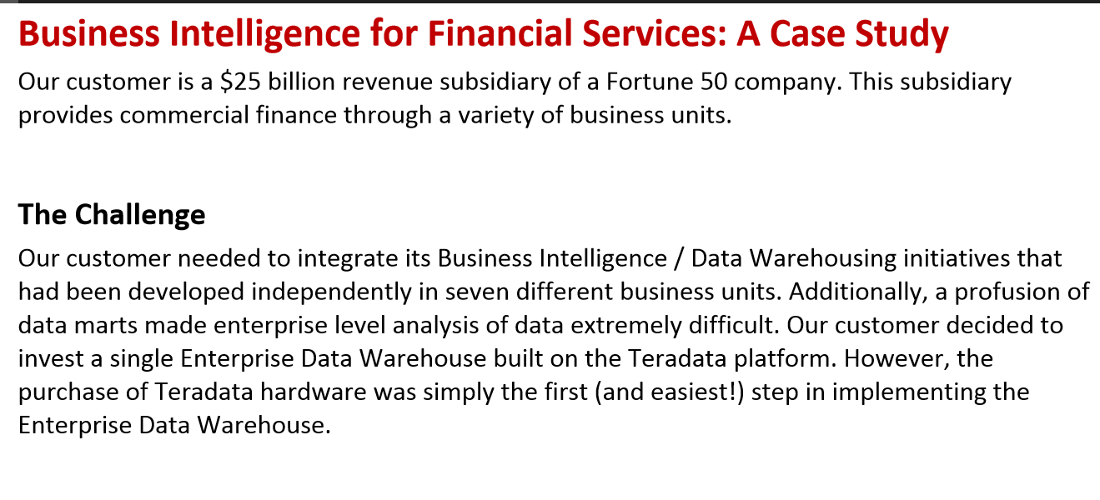

Slide 11
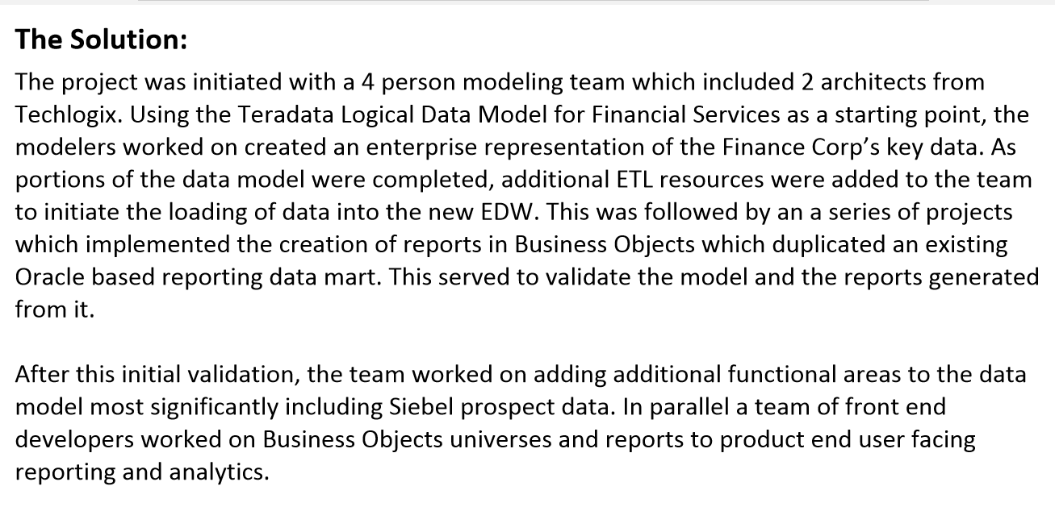

Slide 12
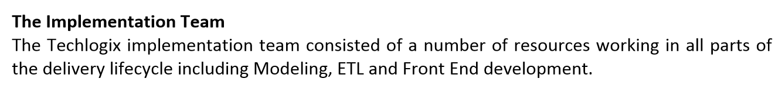
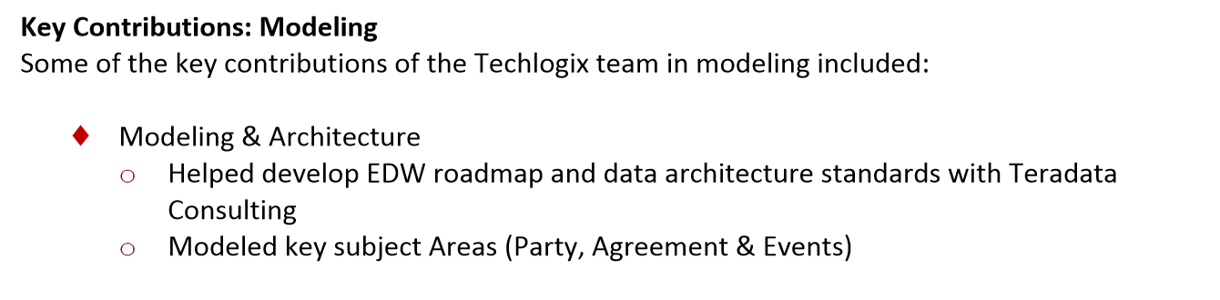

Slide 13
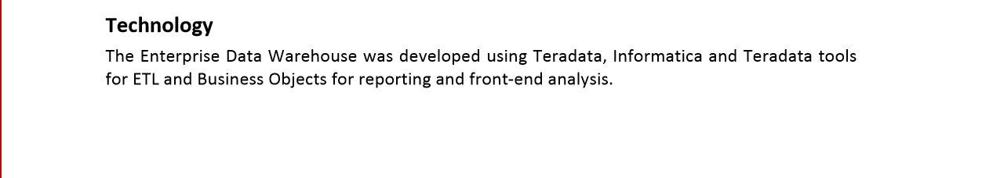
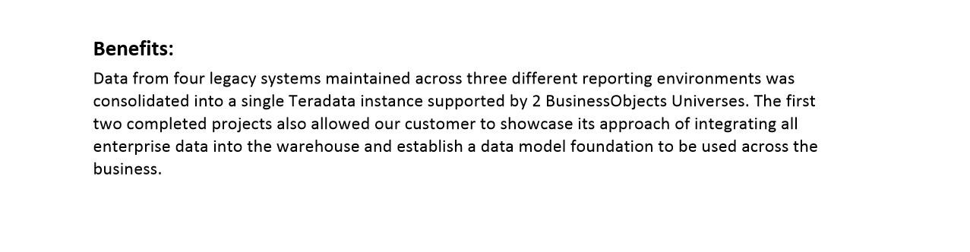
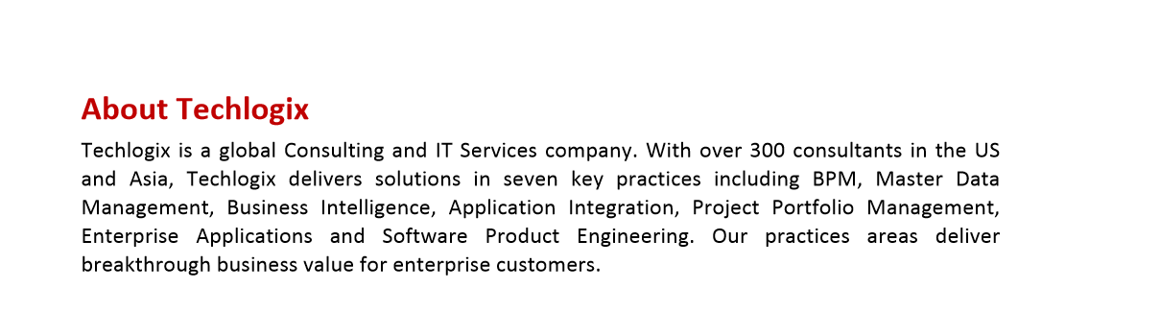

Slide 14
Conclusions:
Your company practices BI on some level. Whether it’s acquiring information, protecting information or massaging the data into a truly useful advantage, you need to be aware of the key developments and pitfalls that are outlined in this report.
Business leaders have long appreciated BI but have only recently been able to harness its power using specialized applications and that show a measurable ROI. As these applications become more refined, look to the leaders in the field to help your company make the most of its collective data. Finally, be aware of the acceptable means of acquiring data and be cognizant of the means by which others can acquire information about your business. The opportunities may be huge but the mistakes can be devastating.

Slide 15


